Slide 1

Session 9.1
Bachelors degree in bioinformatics
CLUSTERING METHODS AND ALGORITHMS IN GENOMICS AND EVOLUTION
Distance based methods for tree inference
Course 2023-2024

Slide 2
Outline
Transforming Distance Matrices into Evolutionary Trees
Toward an Algorithm for Distance-Based Phylogeny Construction
Additive Phylogeny
Ultrametric Evolutionary Trees (UPGMA reconstruction)
The Neibour-Joining Algorithm
Using Least-Squares to construct Distance-Based Phylogenies

Slide 3
Neighbor-Joining Theorem
Given an n x n distance matrix D, its neighbor-joining matrix is the matrix D* defined as
D*_{i,j} = (n - 2)· D_{i,j} – TotalDistance_{D}(i) – TotalDistance_{D}(j),
Where TotalDistance_{D}(i) is the sum of distance from i to all other leaves .

Slide 4
Neighbor-Joining Theorem
Given an n x n distance matrix D, its neighbor-joining matrix is the matrix D* defined as
D*_{I,j} = (n - 2)· D_{i,j} – TotalDistance_{D}(i) – TotalDistance_{D}(j),
Where TotalDistance_{D}(i) is the sum of distance from i to all other leaves .
 | i | j | k | l
i | 0 | 13 | 21 | 22
j | 13 | 0 | 12 | 13
k | 21 | 12 | 0 | 13
l | 22 | 13 | 13 | 0
TotalDistance_{D}
 | i | j | k | l
i | 0 | -68 | -60 | -60
j | -68 | 0 | -60 | -60
k | -60 | -60 | 0 | -68
l | -60 | -60 | -68 | 0
56
38
46
48
D
D*

Slide 5
Neighbor-Joining in Action
Neighbor-Joining Theorem: If D is additive, then the smallest element of D* corresponds to neighboring leaves in Tree(D).
 | i | j | k | l
i | 0 | 13 | 21 | 22
j | 13 | 0 | 12 | 13
k | 21 | 12 | 0 | 13
l | 22 | 13 | 13 | 0
TotalDistance_{D}
 | i | j | k | l
i | 0 | -68 | -60 | -60
j | -68 | 0 | -60 | -60
k | -60 | -60 | 0 | -68
l | -60 | -60 | -68 | 0
56
38
46
48
D
D*

Slide 6
Neighbor-Joining in Action
 | i | j | k | l
i | 0 | -68 | -60 | -60
j | -68 | 0 | -60 | -60
k | -60 | -60 | 0 | -68
l | -60 | -60 | -68 | 0
TotalDistance_{D}
56
38
46
48
D*
1. Construct neighbor-joining matrix D* from D.

Slide 7
Neighbor-Joining in Action
 | i | j | k | l
i | 0 | -68 | -60 | -60
j | -68 | 0 | -60 | -60
k | -60 | -60 | 0 | -68
l | -60 | -60 | -68 | 0
TotalDistance_{D}
56
38
46
48
D*
2. Find a minimum element D*_{ij} of D*.

Slide 8
Neighbor-Joining in Action
 | i | j | k | l
i | 0 | -68 | -60 | -60
j | -68 | 0 | -60 | -60
k | -60 | -60 | 0 | -68
l | -60 | -60 | -68 | 0
TotalDistance_{D}
56
38
46
48
D*
2. Find a minimum element D*_{ij} of D*.

Slide 9
Neighbor-Joining in Action
 | i | j | k | l
i | 0 | -68 | -60 | -60
j | -68 | 0 | -60 | -60
k | -60 | -60 | 0 | -68
l | -60 | -60 | -68 | 0
TotalDistance_{D}
56
38
46
48
D*
∆_{i,j} = (56-38)/(4-2)= 9
3. Compute ∆_{i,j} = (TotalDistance_{D}(i) – TotalDistance_{D}(j))/(n-2).

Slide 10
Neighbor-Joining in Action
 | i | j | k | l
i | 0 | 13 | 21 | 22
j | 13 | 0 | 12 | 13
k | 21 | 12 | 0 | 13
l | 22 | 13 | 13 | 0
TotalDistance_{D}
56
38
46
48
D
∆_{i,j} = (56-38)/(4-2)= 9
LimbLength(i) = ½(13 + 9) = 11
LimbLength(j) = ½(13 - 9) = 2
4. Set LimbLength(i) equal to ½(D_{i,j} + ∆_{i,j} ) and LimbLength(j) equal to ½(D_{i,j} - ∆_{i,j} ).

Slide 11
Neighbor-Joining in Action
 | m | k | l
m | 0 | 10 | 11
k | 10 | 0 | 13
l | 11 | 13 | 0
TotalDistance_{D}
21
23
24
D’
5. Form a matrix D’ by removing i-th and j-th row/column from D and adding an m-th row/column such that for any k, D_{k,m} = (D_{i,k} + D_{j,k} - D_{i,j})/2.

Slide 12
Neighbor-Joining in Action
Tree(D’)
 | m | k | l
m | 0 | 10 | 11
k | 10 | 0 | 13
l | 11 | 13 | 0
i
6
k
D’
4
m
j
7
l
6. Apply Neighbor-Joining to D’ to obtain Tree(D’).

Slide 13
Neighbor-Joining in Action
Tree(D’)
 | m | k | l
m | 0 | 10 | 11
k | 10 | 0 | 13
l | 11 | 13 | 0
i
11
6
k
D’
4
j
2
7
l
LimbLength(i) = ½(13 + 9) = 11
LimbLength(j) = ½(13 - 9) = 2
7. Reattach limb of i and j to obtain Tree(D).

Slide 14
Neighbor-Joining
Construct neighbor-joining matrix D* from D.
Find a minimum element D*_{ij} of D*.
Compute ∆_{i,j} = (TotalDistance_{D}(i) – TotalDistance_{D}(j))/(n-2).
Set LimbLength(i) equal to ½(D_{i,j} + ∆_{i,j} ) and LimbLength(j) equal to ½(D_{i,j} - ∆_{i,j} ).
Form a matrix D’ by removing i-th and j-th row/column from D and adding an m-th row/column such that for any k, D_{k,m} = (D_{i,k} + D_{j,k} - D_{i,j})/2.
Apply Neighbor-Joining to D’ to obtain Tree(D’).
Reattach limb of i and j to obtain Tree(D).

Slide 15
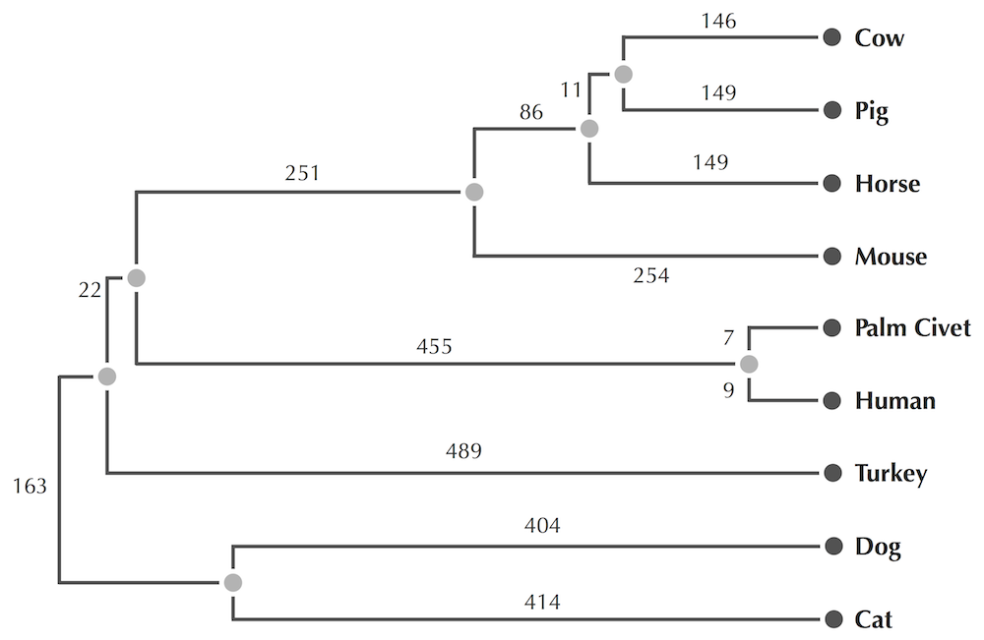
Neighbor-Joining on Coronoviruses

Slide 16
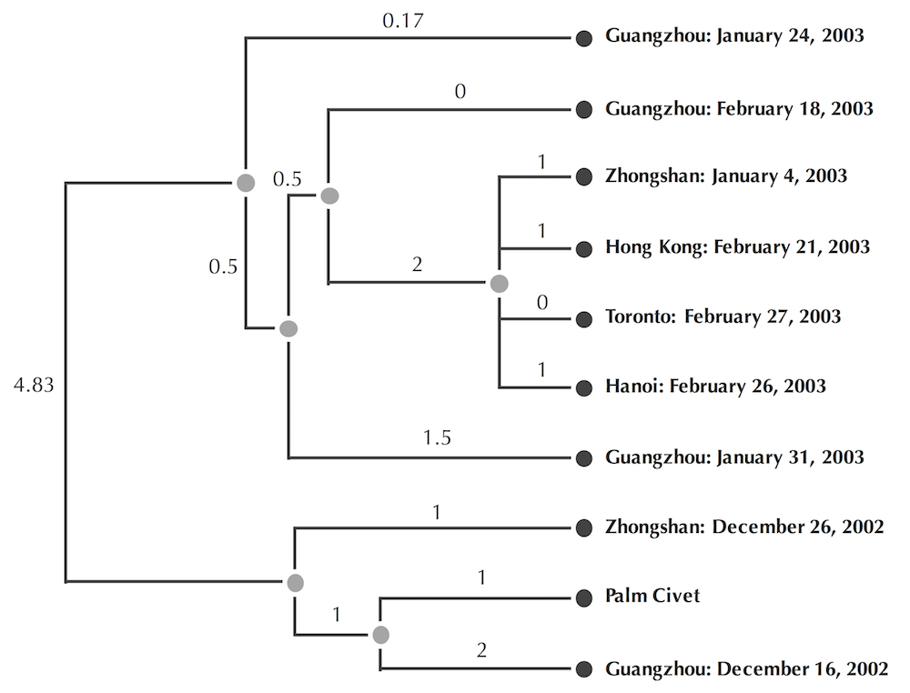
Neighbor-Joining on Coronoviruses

Slide 17
Exercise Break
Below is a distance matrix D. Compute D*_{k,l} where D* is the neighbor-joining matrix of D.
Below is a distance matrix D. After the neighbor- joining algorithm decides that j and k are neighbors, compute LimbLength(k).

Slide 18
Outline
Transforming Distance Matrices into Evolutionary Trees
Toward an Algorithm for Distance-Based Phylogeny Construction
Additive Phylogeny
Ultrametric Evolutionary Trees (UPGMA reconstruction)
The Neibour-Joining Algorithm
Using Least-Squares to construct Distance-Based Phylogenies

Slide 19
Sum of Squared Errors
i
1.5
1
k
1.5
T
j
1.5
1
l
 | i | j | k | l
i | 0 | 3 | 4 | 3
j | 3 | 0 | 4 | 5
k | 4 | 4 | 0 | 2
l | 3 | 5 | 2 | 0
D

Slide 20
Sum of Squared Errors
i
1.5
1
k
1.5
T
j
1.5
1
l
 | i | j | k | l
i | 0 | 3 | 4 | 3
j | 3 | 0 | 4 | 5
k | 4 | 4 | 0 | 2
l | 3 | 5 | 2 | 0
 | i | j | k | l
i | 0 | 3 | 4 | 4
j | 3 | 0 | 4 | 4
k | 4 | 4 | 0 | 2
l | 4 | 4 | 2 | 0
D
d

Slide 21
Sum of Squared Errors
i
1.5
1
k
1.5
T
j
1.5
1
l
 | i | j | k | l
i | 0 | 3 | 4 | 3
j | 3 | 0 | 4 | 5
k | 4 | 4 | 0 | 2
l | 3 | 5 | 2 | 0
 | i | j | k | l
i | 0 | 3 | 4 | 4
j | 3 | 0 | 4 | 4
k | 4 | 4 | 0 | 2
l | 4 | 4 | 2 | 0
D
d

Slide 22
Sum of Squared Errors
Discrepancy(T, D) = ∑_{1≤i<j≤n} (d_{i,j}(T) – D_{i,j})²
i
1.5
1
k
1.5
T
j
1.5
1
l
 | i | j | k | l
i | 0 | 3 | 4 | 3
j | 3 | 0 | 4 | 5
k | 4 | 4 | 0 | 2
l | 3 | 5 | 2 | 0
 | i | j | k | l
i | 0 | 3 | 4 | 4
j | 3 | 0 | 4 | 4
k | 4 | 4 | 0 | 2
l | 4 | 4 | 2 | 0
D
d

Slide 23
Sum of Squared Errors
Discrepancy(T, D) = ∑_{1≤i<j≤n} (d_{i,j}(T) – D_{i,j})²
= 1²+1²=2
i
1.5
1
k
1.5
T
j
1.5
1
l
 | i | j | k | l
i | 0 | 3 | 4 | 3
j | 3 | 0 | 4 | 5
k | 4 | 4 | 0 | 2
l | 3 | 5 | 2 | 0
 | i | j | k | l
i | 0 | 3 | 4 | 4
j | 3 | 0 | 4 | 4
k | 4 | 4 | 0 | 2
l | 4 | 4 | 2 | 0
D
d

Slide 24
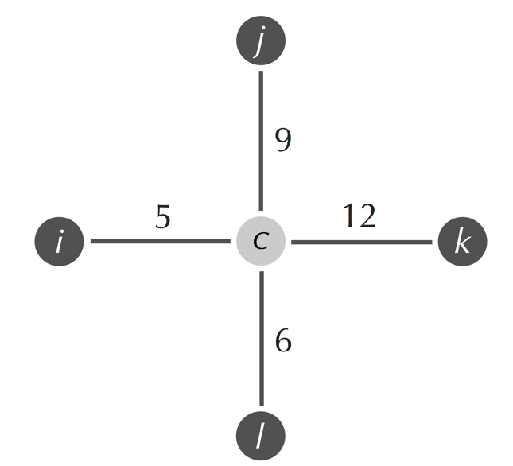
Exercise Break
Compute the sum of squared errors Discrepancy(T,D) for the tree T and distance martrix D given below.

Slide 25
Sum of Squared Errors
Exercise Break: Assign lengths to edges in T in order to minimize Discrepancy(T, D)
i
?
?
k
?
T
j
?
?
l
 | i | j | k | l
i | 0 | 3 | 4 | 3
j | 3 | 0 | 4 | 5
k | 4 | 4 | 0 | 2
l | 3 | 5 | 2 | 0
 | i | j | k | l
i | 0 | ? | ? | ?
j | ? | 0 | ? | ?
k | ? | ? | 0 | ?
l | ? | ? | ? | 0
D
d

Slide 26
Least-Squares Phylogeny
Least-Squares Distance-Based Phylogeny Problem:
Given a distance matrix, find the tree that minimizes the sum of squared errors.
Input: An n x n distance matrix D.
Output: A weighted tree T with n leaves minimizing Discrepancy(T, D) over all weighted trees with n leaves.
Notes:
Slide: In general, there is a polynomial algorithm that will minimize the sum of squared errors if we are given the structure of the tree (T) in advance,
but in practice, we're not going to know the structure of the tree in advance, so we'll need to minimize the sum of squared errors over all possible tree structures.

Slide 27
Weakness of Distance-Based Methods
Distance-based algorithms for evolutionary tree reconstruction say nothing about ancestral states at internal nodes.
We lost information when we converted a multiple alignment to a distance matrix...
Species | Alignment | Distance Matrix
 |  | Chimp | Human | Seal | Whale
Chimp | ACGTAGGCCT | 0 | 3 | 6 | 4
Human | ATGTAAGACT | 3 | 0 | 7 | 5
Seal | TCGAGAGCAC | 6 | 7 | 0 | 2
Whale | TCGAAAGCAT | 4 | 5 | 2 | 0

Slide 28
Session 9.2
Bachelors degree in bioinformatics
CLUSTERING METHODS AND ALGORITHMS IN GENOMICS AND EVOLUTION
Character based methods for tree inference
Course 2023-2024

Slide 29
Outline
Character-Based Tree Reconstruction
The Small Parsimony Problem
The Large Parsimony Problem
Tree thinking
Evolutionary Tree Reconstruction in the Modern Era

Slide 30
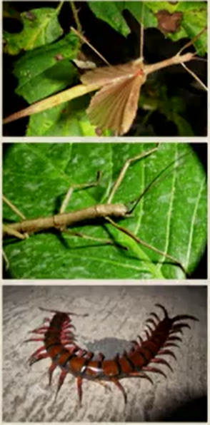
Character Tables
Fifty years ago, researcher constructed trees from anatomical/physiological properties called characters.
 | Wings | Legs
Winged stick insect | Yes | 6
Wingless stick insect | No | 6
Giant cetipede | No | 42

Slide 31
Character-Based Phylogeny
Character-Based Phylogeny Problem: Reconstruct a phylogeny from characters.
Input: An n x m character table for n species and m characters.
Output: A tree in which species with similar character values occur near each other.

Slide 32
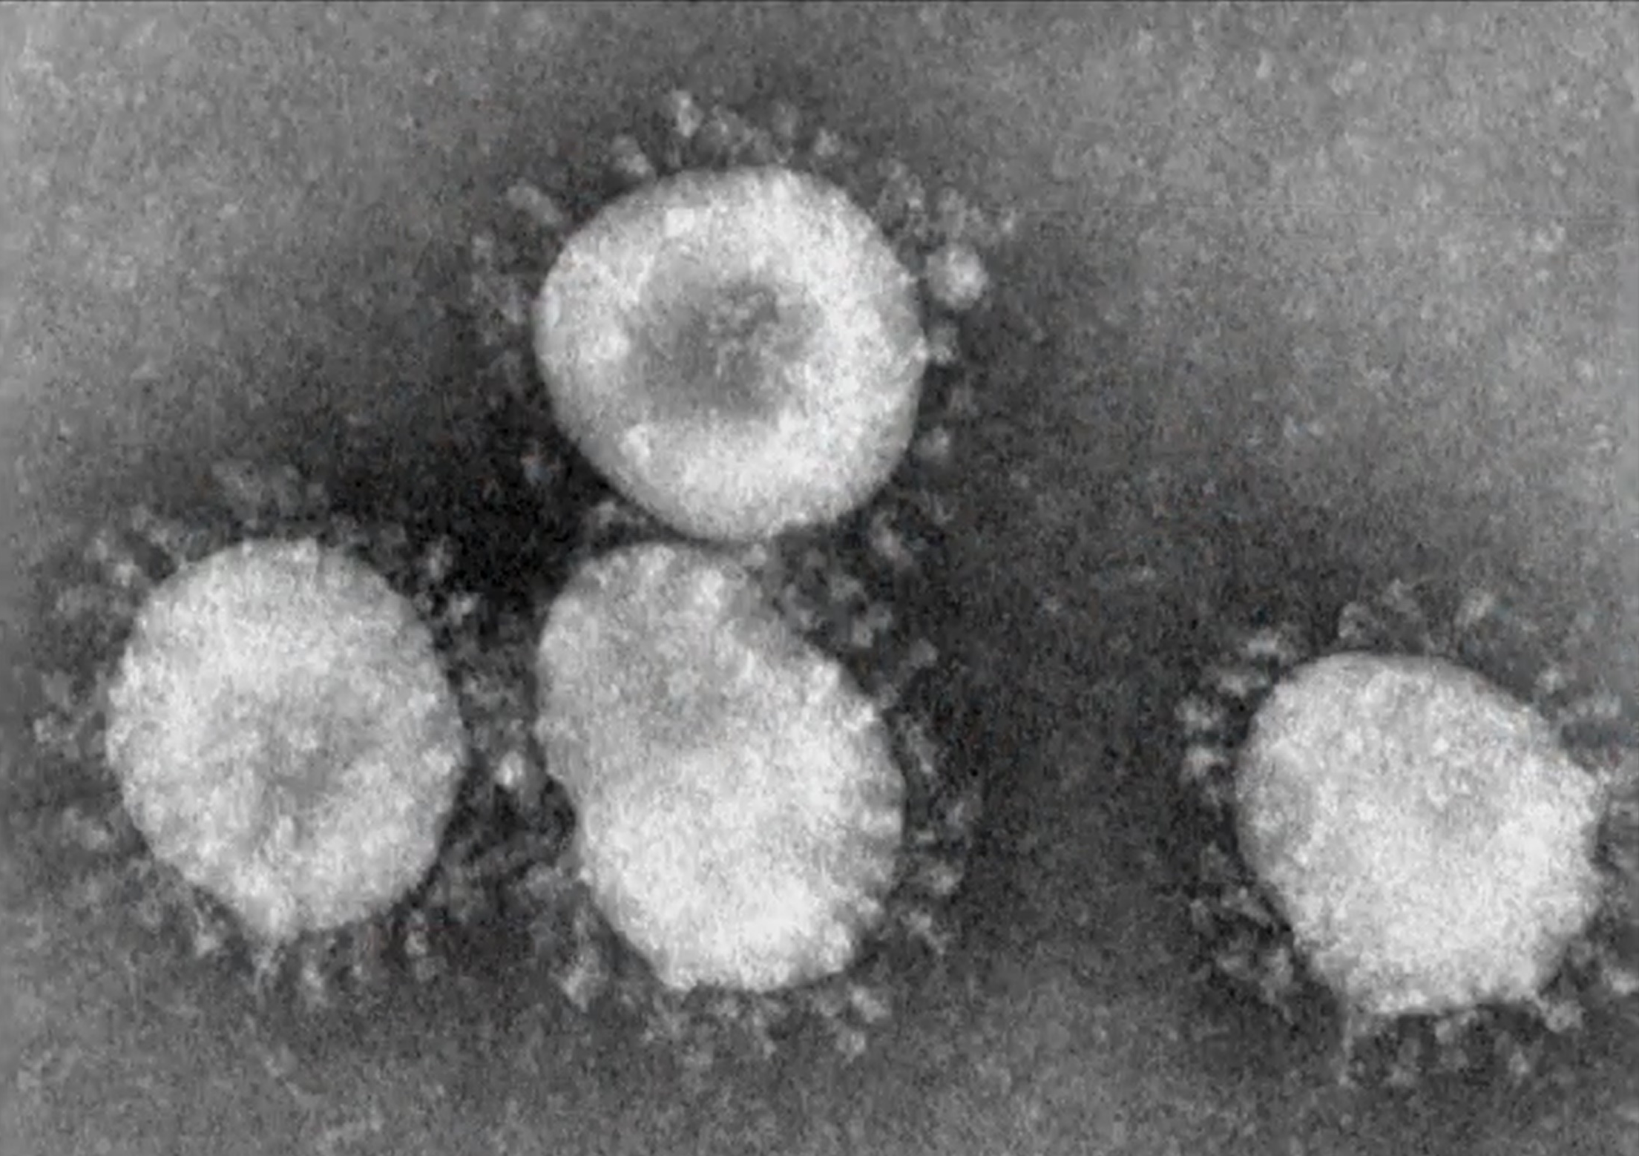
Try to construct a coronavirus phylogeny from anatomical characters....

Slide 33
From Characters to a Phylogeny
STOP and Think: How would you construct an evolutionary tree from character?

Slide 34
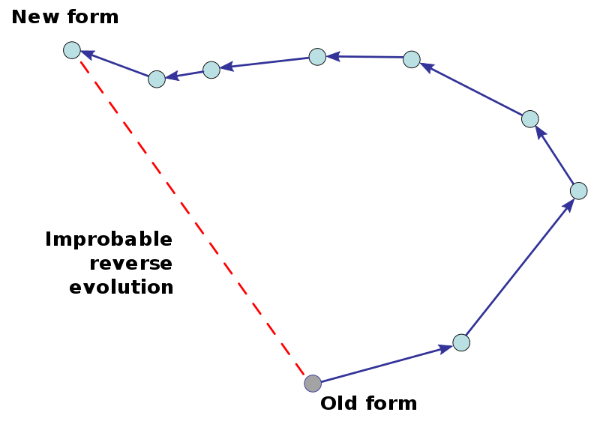
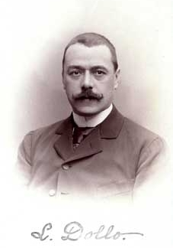
Dollo’s law of irreversibility
…an organism never returns exactly to a former state, even if it finds itself placed in conditions of existence identical to those in which it has previously lived ... it always keeps some trace of the intermediate stages through which it has passed.
Louis Dollo, 1893
Once an organism has evolved in a certain way, it will not return exactly to a previous form. This is illustrated here in two dimensions; in reality, both biomolecules and organisms evolve in many different dimensions.
1857-1931

Slide 35
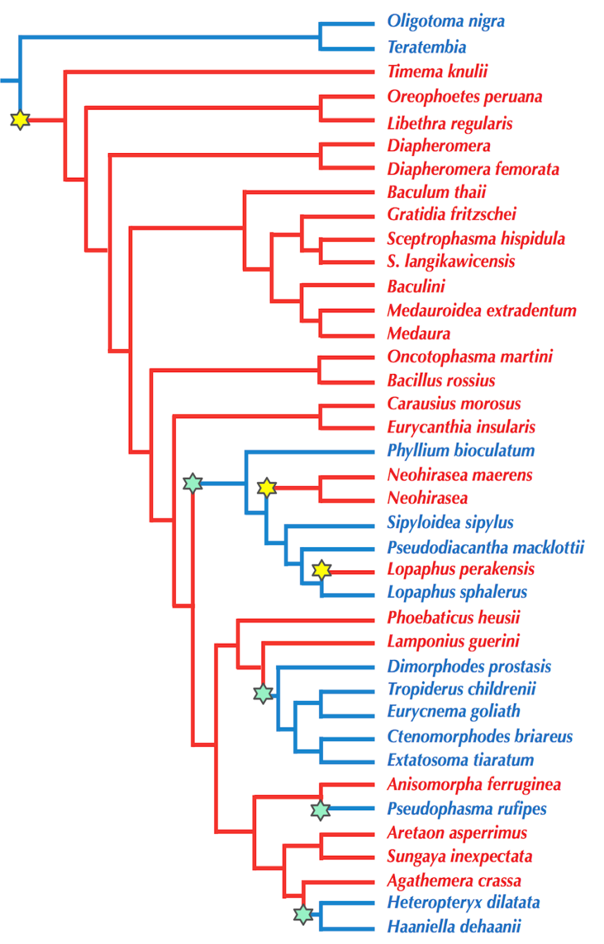
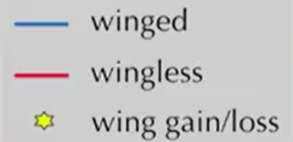
Dollo’s Principle Violated
Evolutionary tree of winged and wingless stick insects constructed from 18S ribosomal RNA genes.
Transitions from winged to wingless species are shown by yellow stars; transitions from wingless to winged species are shown by blue stars.
18S ribosomal RNAs are slow-evolving, making them ideal for reconstructing ancient divergences.
In 2003, Michael Whiting studied various winged and wingless stick insects from around the world and refuted this argument.
Wings were gained or lost at seven different times in stick insects alone, shown here by stars.

Slide 36
Dollo’s Principle Violated
STOP and Think: What do you think has happened?

Slide 37
An Alignment As a Character Table
Species | Alignment
Chimp | ACGTAGGCCT
Human | ATGTAAGACT
Seal | TCGAGAGCAC
Whale | TCGAAAGCAT
We can bypass such issues using genetic data as characters.

Slide 38
An Alignment As a Character Table
Species | Alignment
Chimp | ACGTAGGCCT
Human | ATGTAAGACT
Seal | TCGAGAGCAC
Whale | TCGAAAGCAT
n species
m characters
The question is how to use this character table constructed from the multiple alignment, in order to reconstruct ancestral states.

Slide 39
Outline
Character-Based Tree Reconstruction
The Small Parsimony Problem
The Large Parsimony Problem
Tree Thinking
Evolutionary Tree Reconstruction in the Modern Era

Slide 40
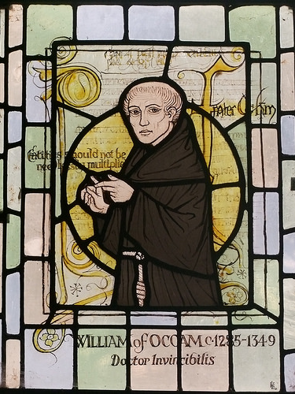
Definition of Parsimony
Maximum parsimony is an optimality criterion under which the phylogenetic tree that minimizes the total number of character-state changes is to be preferred:
the shortest possible tree that explains the data is considered best.
(J.S. Farris 1970; W.M. Fitch 1971)
Occam's razor - a principle of theoretical parsimony: all else being equal—the simplest hypothesis that explains the data should be selected (William of Ockham, 1320s).
English Franciscan friar,
scholastic philosopher and theologian

Slide 41
Toward a Computational Problem
Species | Alignment
Chimp | ACGTAGGCCT
Human | ATGTAAGACT
Seal | TCGAGAGCAC
Whale | TCGAAAGCAT
n species
m characters (4 values)
We can think about a multiple alignment as a character table of its own, for which each of the m columns of this multiple alignment can be viewed as a character.

Slide 42
Toward a Computational Problem
Species | Alignment
Chimp | ACGTAGGCCT
Human | ATGTAAGACT
Seal | TCGAGAGCAC
Whale | TCGAAAGCAT
Our goal: using this multiple alignment, reconstruct the most likely ancestral sequences.
So, we need some way of determining how good an assignment of ancestral sequences is for a given tree.
??????????
??????????
??????????
ACGTAGGCCT
ATGTAAGACT
TCGAGAGCAC
TCGAAAGCAT
Chimp
Human
Seal
Whale

Slide 43
Toward a Computational Problem
ACGAAAGCCT
ACGTAAGCCT
TCGAAAGCAT
ACGTAGGCCT
ATGTAAGACT
TCGAGAGCAC
TCGAAAGCAT
Chimp
Human
Seal
Whale

Slide 44
Toward a Computational Problem
Parsimony score: sum of Hamming distances along each edge.
Hamming distance between two strings of equal length is the number of positions at which the corresponding symbols are different. It measures the minimum number of substitutions required to change one string into the other.
ACGAAAGCCT
1
2
ACGTAAGCCT
TCGAAAGCAT
1
2
2
0
ACGTAGGCCT
ATGTAAGACT
TCGAGAGCAC
TCGAAAGCAT
Chimp
Human
Seal
Whale

Slide 45
Toward a Computational Problem
Parsimony score: sum of Hamming distances along each edge.
Parsimony score: 8
ACGAAAGCCT
1
2
ACGTAAGCCT
TCGAAAGCAT
1
2
2
0
ACGTAGGCCT
ATGTAAGACT
TCGAGAGCAC
TCGAAAGCAT
Chimp
Human
Seal
Whale

Slide 46
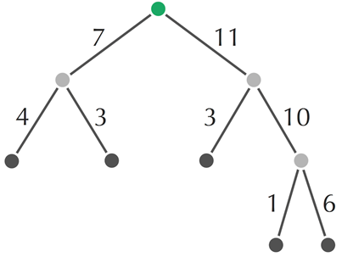
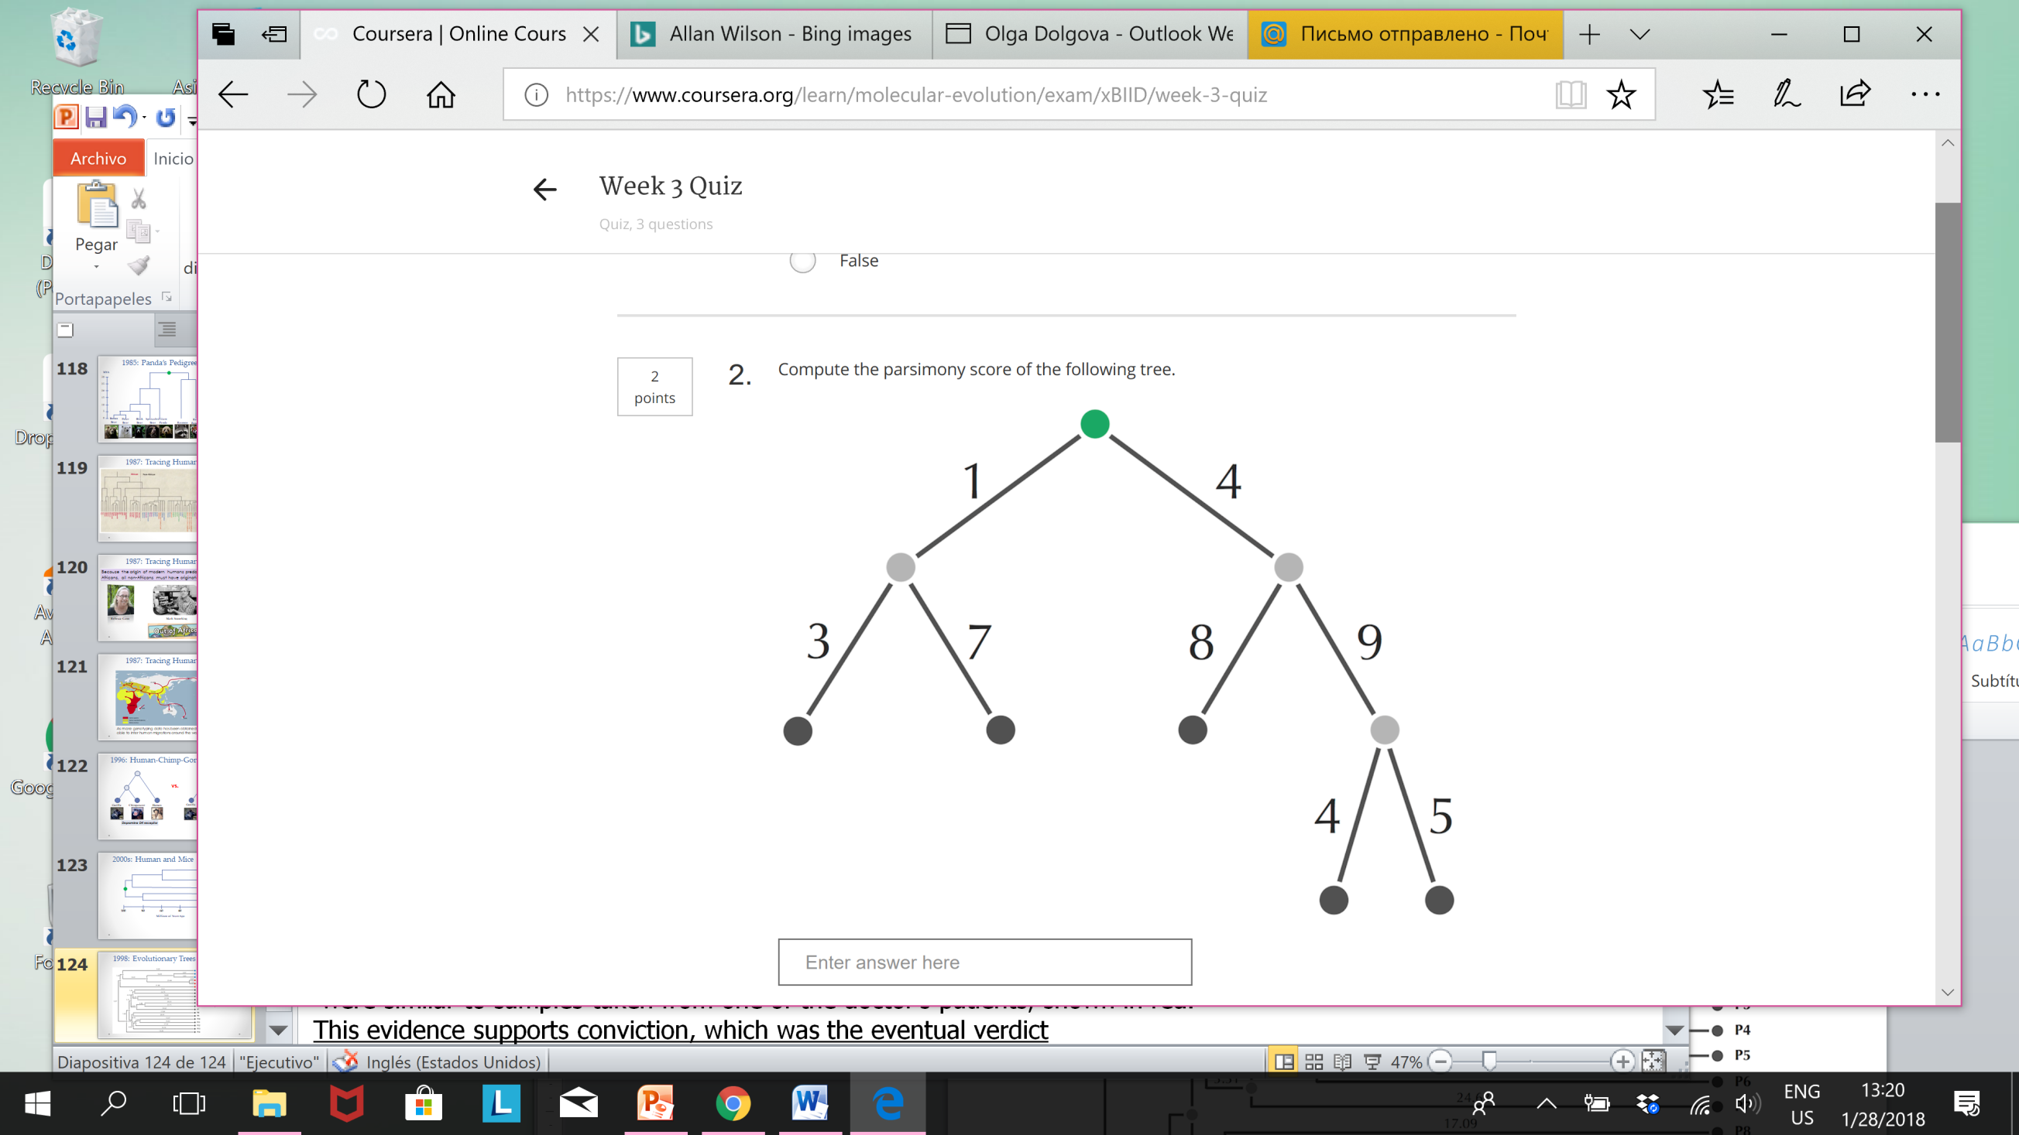
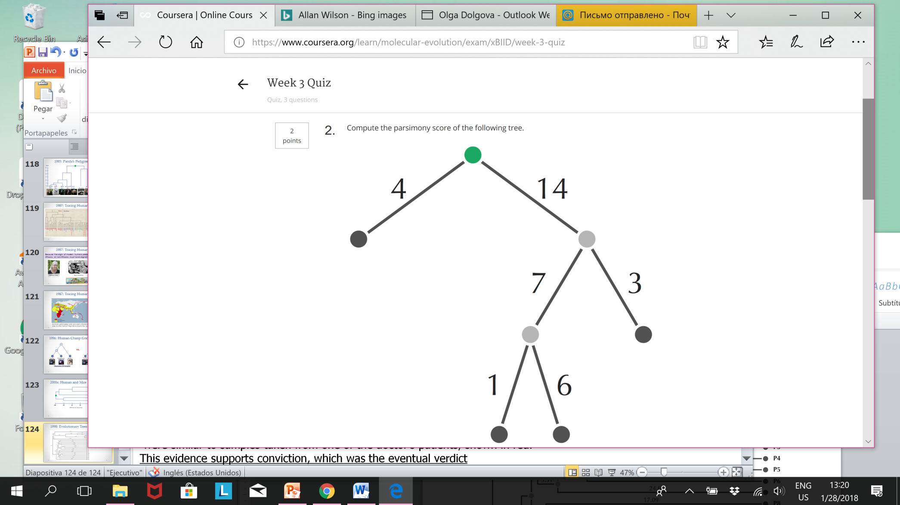
Exercise Break
Compute the parsimony score of the following trees.

Slide 47
Toward a Computational Problem
Small Parsimony Problem: Find the most parsimonious labeling of the internal nodes of a rooted tree.
Input: A rooted binary tree with each leaf labeled by a string of length m.
Output: A labeling of all other nodes of the tree by string of length m that minimizes the tree’s parsimony score.
Our goal is to assign ancestral sequences to this tree in order to minimize the parsimony score.
Notes:
Slide: and our goal is to assign ancestral sequences to this tree in order to minimize the parsimony score.

Slide 48
Toward a Computational Problem
Small Parsimony Problem: Find the most parsimonious labeling of the internal nodes of a rooted tree.
Input: A rooted binary tree with each leaf labeled by a string of length m.
Output: A labeling of all other nodes of the tree by string of length m that minimizes the tree’s parsimony score.
STOP and Think: Is there any way we can simplify this problem statement?

Slide 49
Toward a Computational Problem
We can work with one symbol of each string at a time.
ACGAAAGCCT
ACGTAAGCCT
TCGAAAGCAT
ACGTAGGCCT
ATGTAAGACT
TCGAGAGCAC
TCGAAAGCAT
Chimp
Human
Seal
Whale

Slide 50
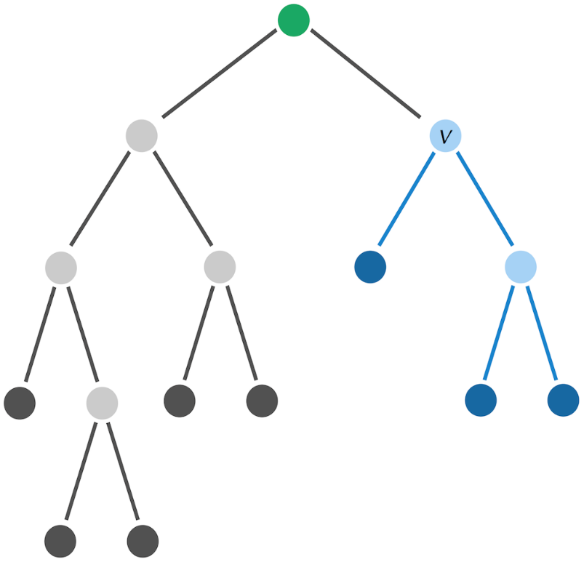
A Dynamic Programming Algorithm
assumes that each string is just a single symbol
Let T_{v} denote the subtree of T whose root is v.
T_{v}

Slide 51
A Dynamic Programming Algorithm
Let T_{v} denote the subtree of T whose root is v.
T_{v}
Define s_{k}(v) as the minimum parsimony score of T_{v} over all labelings of T_{v}, assuming that v is labeled by k.
The minimum parsimony score for the tree T is equal the minimum value of s_{k}(root) over all symbols k.
The idea of dynamic programming algorithm: starting at the leaves of the tree, compute the values s_{k} upward from the leaves to the root, and then use this fact to find the minimum parsimony score.

Slide 52
A Dynamic Programming Algorithm
We need a recurrence relation for the score of a node v in terms of its two “children”.
For symbols i and j, define
δ_{i,j} = 0 if i = j
δ_{i,j} = 1 otherwise.
T_{v}
Recurrence relation:
s_{k}(v)=min_{all symbols i} {s_{i}(Daughter(v))+δ_{i,k}}+min_{all symbols j}{s_{j}(Son(v))+δ_{j,k}}

Slide 53
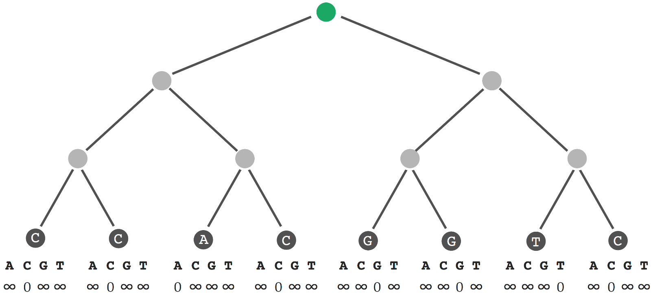
A Dynamic Programming Algorithm
Initializing values s_{k}(v) for all leaves v, represented above as an array for each leaf.
We set s_{k}(v) equal to zero if the leaf is labeled by symbol k; otherwise, we set s_{k}(v) equal to infinity.
0
0
0
0
0
0
0
0
At each node v, an array is going to hold the set of scores s_{k}(v) for each possible symbol k. Here we're working with DNA, so there will be four symbols k.
s_{k}(v)=min_{all symbols i} {s_{i}(Daughter(v))+δ_{i,k}}+min_{all symbols j}{s_{j}(Son(v))+δ_{j,k}}

Slide 54
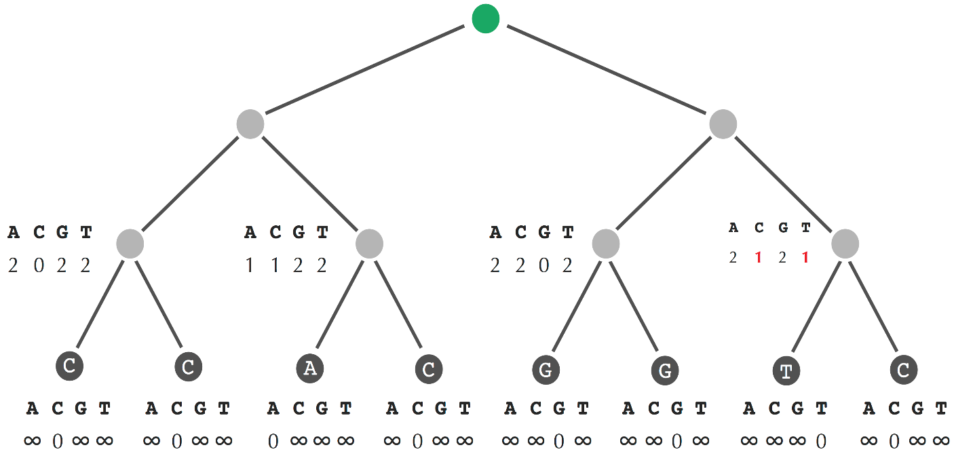
A Dynamic Programming Algorithm
Moving up a level, we apply the recurrence relation.
In the left most node, the two children are fixed as equal to C. So the score of this node is going to be 0 if we assign it a C, since there will be no conflicts between these two edges.
Red indicates the minimum score at each step.
0
1
1
0
1
1
0
0
0
0
0
0
0
0
s_{k}(v)=min_{all symbols i} {s_{i}(Daughter(v))+δ_{i,k}}+min_{all symbols j}{s_{j}(Son(v))+δ_{j,k}}

Slide 55
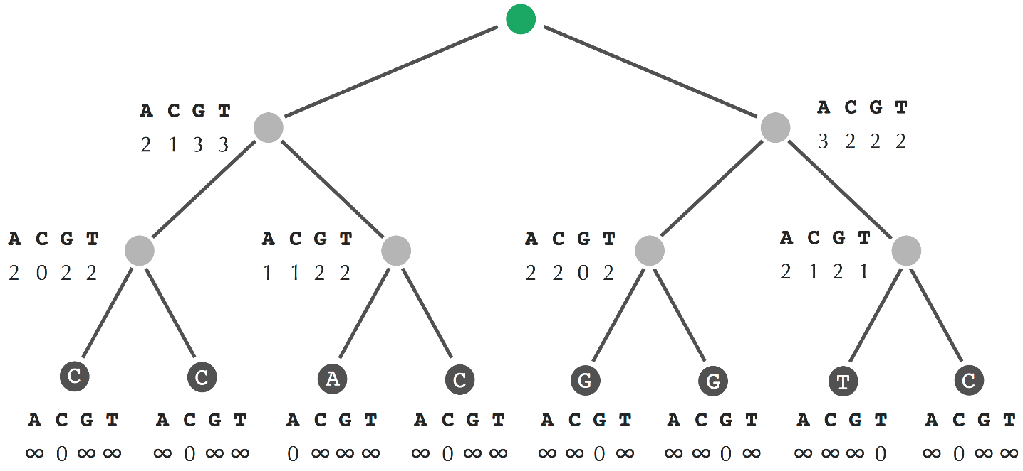
A Dynamic Programming Algorithm
1
2
2
2
0
1
1
0
1
1
0
0
0
0
0
0
0
0
s_{k}(v)=min_{all symbols i} {s_{i}(Daughter(v))+δ_{i,k}}+min_{all symbols j}{s_{j}(Son(v))+δ_{j,k}}

Slide 56
A Dynamic Programming Algorithm
A C G T
5 3 5 5
An illustration of Small Parsimony after initialization.
The min parsimony score is equal to the min score at the root, which for this tree is equal to 3.
This value corresponds to symbol C, and so when we begin backtracking to assign symbols to internal nodes, we assign nucleotide C to the root.
C
1
2
2
2
0
1
1
0
1
1
0
0
0
0
0
0
0
0
s_{k}(v)=min_{all symbols i} {s_{i}(Daughter(v))+δ_{i,k}}+min_{all symbols j}{s_{j}(Son(v))+δ_{j,k}}

Slide 57
A Dynamic Programming Algorithm
A C G T
5 3 5 5
To reconstruct the other ancestral states implement a backtracking approach that goes from the root down to the leaves and assign symbols.
C
1
2
2
2
Red elements correspond to minima, but they don't necessarily correspond to an optimal assignment of ancestral symbols.
0
1
1
0
1
1
0
0
0
0
0
0
0
0
Exercise break: “Backtrack” to fill in remaining nodes of the tree.

Slide 58
Small Parsimony for Unrooted Trees
Small Parsimony in an Unrooted Tree Problem: Find the most parsimonious labeling of the internal nodes of an unrooted tree.
Input: An unrooted binary tree with each leaf labeled by a string of length m.
Output: A position of the root and a labeling of all other nodes of the tree by string of length m that minimizes the tree’s parsimony score.
You can find the most parsimonious labeling of the internal nodes in an unrooted tree by placing a root on an arbitrary edge, solving the small parsimony problem for the resulting rooted tree, and then simply removing the root.

Slide 59
Outline
Character-Based Tree Reconstruction
The Small Parsimony Problem
The Large Parsimony Problem
Tree Thinking
Evolutionary Tree Reconstruction in the Modern Era

Slide 60
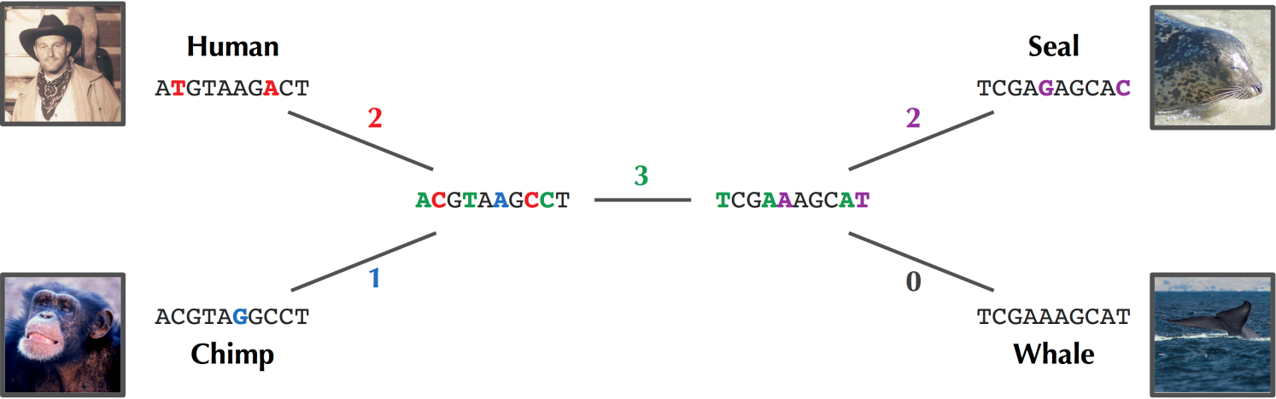
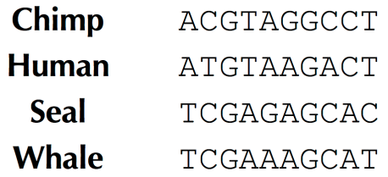
Finding the Most Parsimonious Tree
Parsimony score: 8
Dynamic programming algorithm is able to reconstruct ancestral states in binary trees. But this algorithm assumes that the structure of the tree was given.

Slide 61
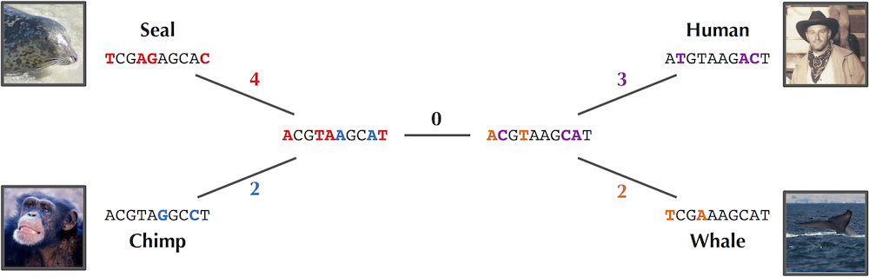
Finding the Most Parsimonious Tree
Parsimony score: 11

Slide 62
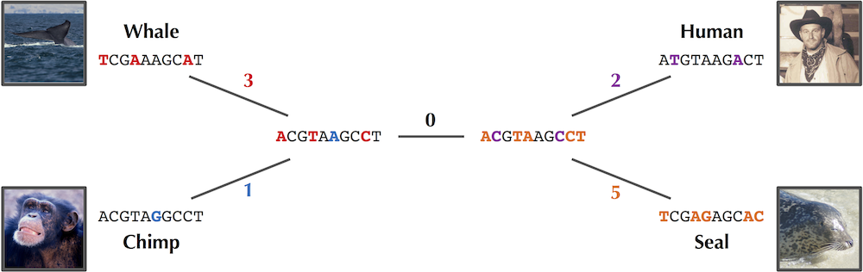
Finding the Most Parsimonious Tree
Parsimony score: 11
When applying the algorithm for small parsimony, it is allowed an internal edge to have weight 0. Because if we were to compress this edge, then we would no longer have a binary tree.

Slide 63
Finding the Most Parsimonious Tree
Large Parsimony Problem: Given a set of strings, find a tree (with leaves labeled by all these strings) having minimum parsimony score.
Input: A collection of strings of equal length.
Output: An unrooted binary tree T minimizing the parsimony score among all possible unrooted binary trees with leaves labeled by these strings.
Unfortunately, this problem is NP-Complete…
So, let's design a greedy heuristic for this problem.

Slide 64
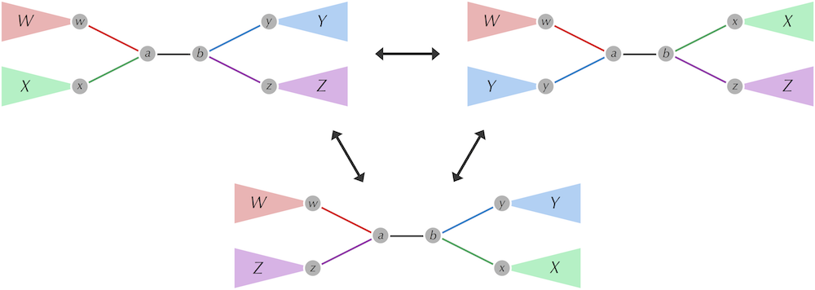
A Greedy Heuristic for Large Parsimony
Removing an internal edge, an edge connecting two internal nodes (along with the nodes), produces four disconnected subtrees (W, X, Y, Z).

Slide 65
A Greedy Heuristic for Large Parsimony
Removing an internal edge, an edge connecting two internal nodes (along with the nodes), produces four disconnected subtrees (W, X, Y, Z).

Slide 66
A Greedy Heuristic for Large Parsimony
Rearranging these subtrees is called a nearest neighbor interchange.
A nearest neighbor interchange on the internal edge (a,b), shown in black, results from rearranging the four colored subtrees W, X, Y, and Z, which are rooted at w, x, y, and z, respectively. The nearest neighbor interchange operation removes one edge connected to a and another edge connected to b, then replaces these edges with two new edges. The three possible tree structures resulting from nearest neighbor interchanges on (a, b) can be represented as WX|YZ (top left), WY|XZ (top right), and WZ|XY (bottom).

Slide 67
A Greedy Heuristic for Large Parsimony
Nearest Neighbors of a Tree Problem: Given an internal edge in an unrooted binary tree, generate the tree’s nearest neighbors .
Input: An internal edge in an unrooted binary tree.
Output: The two nearest neighbors of this tree (with respect to the given internal edge).

Slide 68
A Greedy Heuristic for Large Parsimony
Nearest Neighbors Interchange Heuristic:
Set current tree equal to arbitrary unrooted binary tree structure.
Go through all internal edges and perform all possible nearest neighbor interchange.
Solve Small Parsimony Problem on each tree.
If any tree has parsimony score improving over optimal tree, set it equal to the current tree.
Otherwise, return the current tree.

Slide 69
Outline
Character-Based Tree Reconstruction
The Small Parsimony Problem
The Large Parsimony Problem
Tree Thinking
Evolutionary Tree Reconstruction in the Modern Era

Slide 70
Two (related) meanings of trees
Groupings of similarity/ classification
Ancestry relationships
William and Harry
Eugenie and Beatrice
Zara
Queen Elizabeth II

Slide 71
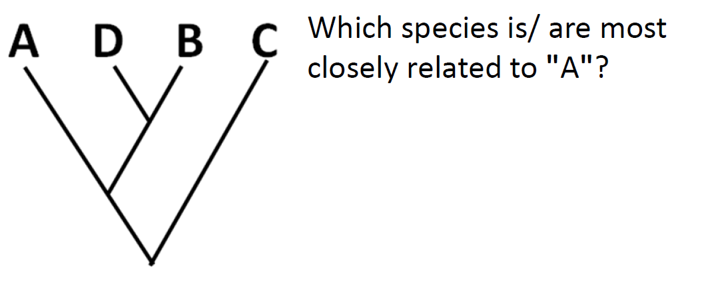
Understanding trees

Slide 72

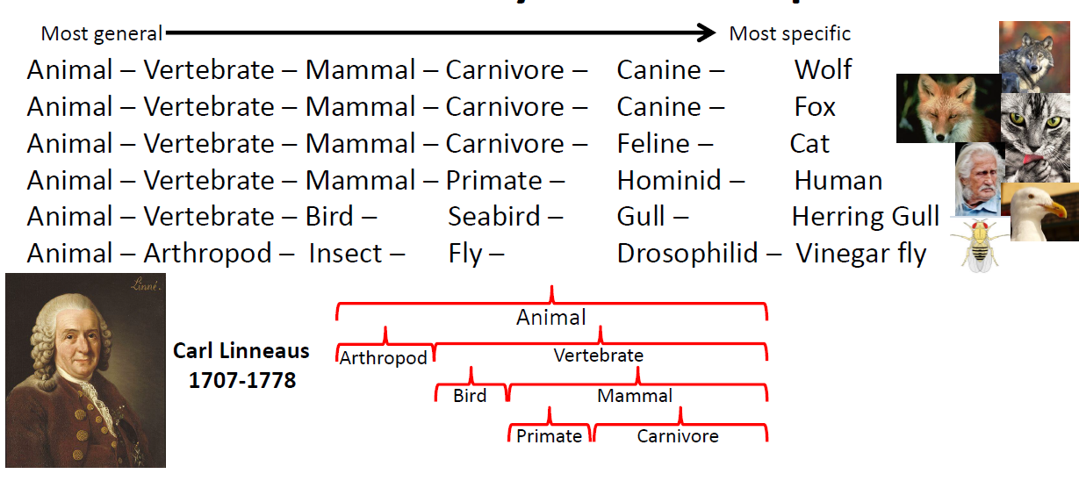
Classification groups imply closer evolutionary relationships

Slide 73
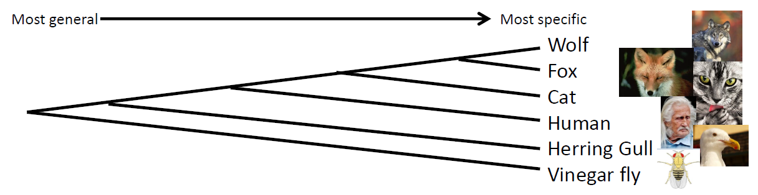
Classification groups imply closer evolutionary relationships

Slide 74
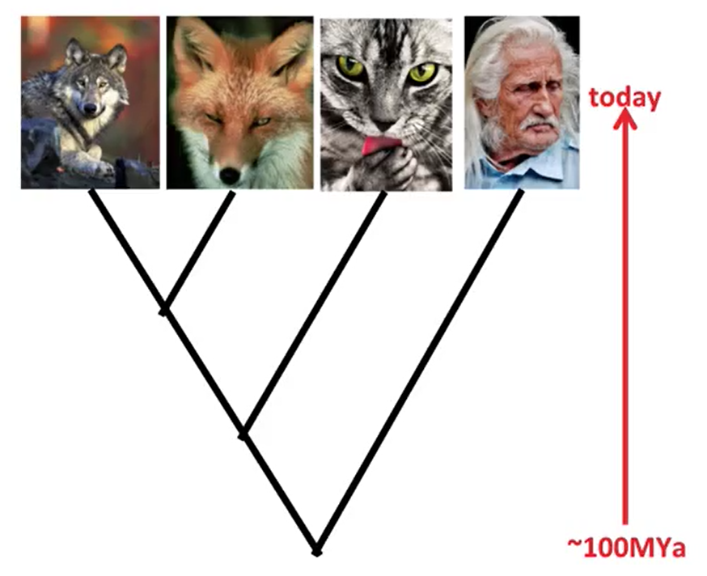
Sample Tree
Leaf, node, branch (edge), root.
Phylogenetic tree depicts the relationship between Operational Taxonomic Units (OTUs).

Slide 75
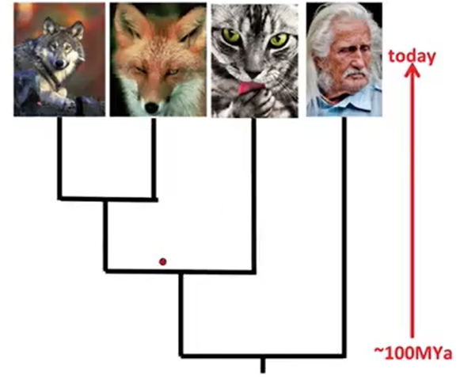
Sample Tree
Leaf, node, branch (edge), root.
Different ways of representing.
Phylogenetic tree depicts the relationship between Operational Taxonomic Units (OTUs).

Slide 76
Sample Tree
Leaf, node, branch (edge), root.
Different ways of representing.
Assess relationship by looking at who shares “common ancestor”.
Phylogenetic tree depicts the relationship between Operational Taxonomic Units (OTUs).

Slide 77
Are these trees different?

Slide 78
Comparing trees
Rotating around a node does not change who is more closely related.

Slide 79
Comparing trees
Notes:
1

Slide 80
Evolutionary assumptions
Summation of relationships
Tree reflects evolutionary history
Common ancestry of all species
Clean splits into two or more taxa (bifurcate)
Once species diverge don’t come back together

Slide 81

Tree thinking: descend with modification
Mutation rate
Time
Fixation rate

Slide 82
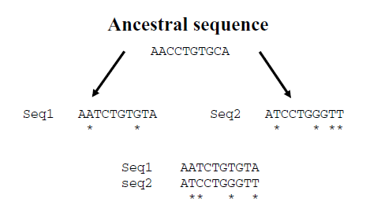
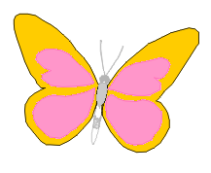
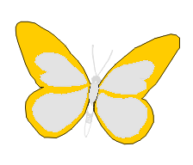
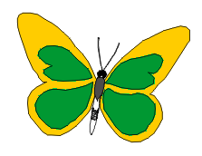
Tree thinking: descend with modification
Speciation
Mutation rate
Time
Fixation rate
+
Reproductive
isolation
Divergence

Slide 83
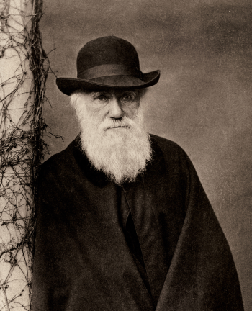
Molecular revolution in the living beings classification
Morphological features vs molecular data
Molecular data (DNA and proteins; genomes)
Universal
Evolve more uniformly
More adequate for quantitative analysis
Much more abundant
Now it is possible to meet the Darwin’s dream and reconstruct “a true genealogy tree of each great kingdom of Nature”.
Charles Darwin
(1809-1882)

Slide 84
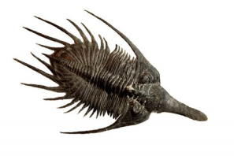
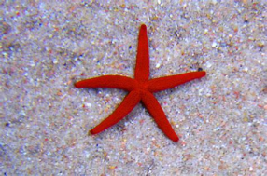
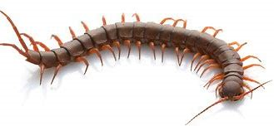
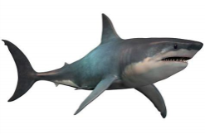
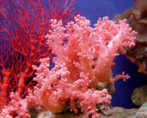
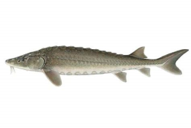
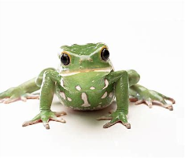
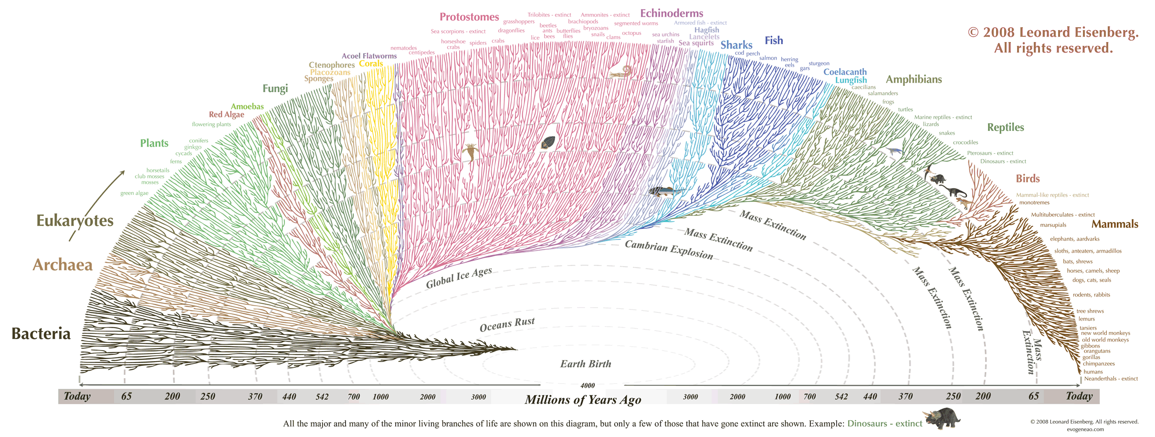
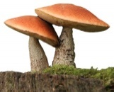
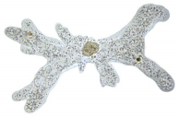
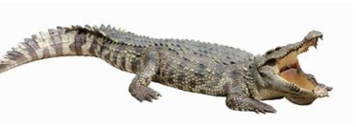


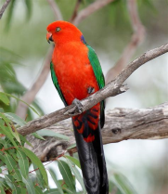
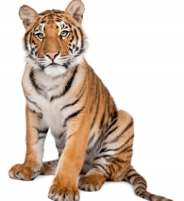
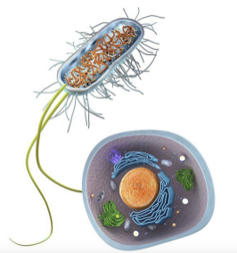
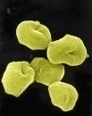

Tree of life

Slide 85
Outline
Character-Based Tree Reconstruction
The Small Parsimony Problem
The Large Parsimony Problem
Tree Thinking
Evolutionary Tree Reconstruction in the Modern Era

Slide 86
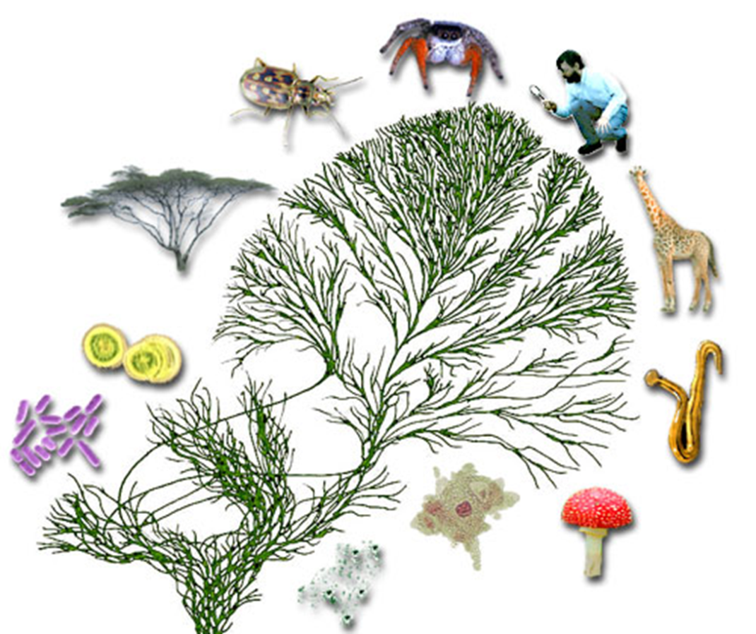
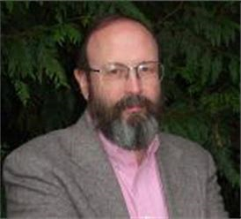
Testing Evolutionary Hypothesis
Broad evolutionary inference requires comparisons among groups
Those comparisons are most meaningful when studied in the context of evolutionary history
Phylogenetics is an estimate of evolutionary history
Phylogenies are fundamental to comparative biology; there is no doing it without taking them into account.
J. Felsenstein

Slide 87
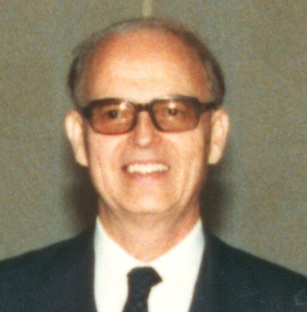


1963: Paradigm Shift in Genetic Analysis
From the point of view of hemoglobin structure, it appears that gorilla is just an abnormal human.
Emile
Zuckerkandl
Linus
Pauling
…that is of course nonsense. What the comparison really indicates is that hemoglobin is a bad choice and has nothing to tell us about attributes, or indeed tells a lie.
Gaylord Simpson

Slide 88

1996: Human-Chimp-Gorilla Ancestry
vs.
Gorilla
Chimpanzee
Human
Gorilla
Chimpanzee
Human
Dopamine D4 receptor
Beta globin

Slide 89
2000s: Human and Mice are Relatives
Whale
Cow
Dog
Human
Mouse
100
80
60
40
20
0
Millions of Years Ago
Many biologists believed that humans are more closely related to dogs than to mice. But recent research has shown otherwise, as indicated by this phylogeny.

Slide 90

1985: Panda’s Pedigree Decoded
Until the 1980s, it was unclear whether the giant panda should be classified as a bear or as a raccoon.
The giant panda looks like a bear in some ways, but it's also similar to raccoons in other ways:
30
25
20
15
10
the panda doesn't hibernate in the winter, and its male genitalia are tiny and backward-pointing.
5
0
Brown
Bear
Polar
Bear
Black
Bear
Spectacled
Bear
Giant
Panda
Red
Panda
Raccoon

Slide 91

1985: Panda’s Pedigree Decoded
MYA
30
25
20
15
Stephen J. O’Brien
10
Whereas using anatomical or behavioral characters led to endless debate in this subject, Steve O'Brien used genetic data in 1985 to demonstrate that the giant panda should, in fact, be considered a bear - a conclusion that has lasted to this day.
5
0
Brown
Bear
Polar
Bear
Black
Bear
Spectacled
Bear
Giant
Panda
Red
Panda
Raccoon

Slide 92

1987: Tracing Human Origins
Evolutionary tree for human populations.
Clear division into Africans, shown in red, and non-Africans, shown in other colors, where each color represents a different continent is observed.
The most recent common ancestor of all non-Africans is at a much more recent point than the most recent common ancestor of all Africans, which is at the root of the tree.

Slide 93




1987: Tracing Human Origins
Because the origin of modern humans predates the origin of all non Africans, all non-Africans must have originated somewhere in Africa.
Rebecca Cann
Mark Stoneking
Allan Wilson

Slide 94

1987: Tracing Human Origins
As more genotyping data has been obtained, researchers have been able to infer human migrations around the world from evolutionary trees.

Slide 95

1998: Evolutionary Trees Fight Crime
A doctor in Louisiana went on trial for the attempted murder of his estranged mistress. She claimed that he had injected her with an HIV-tainted syringe. The evidence supported conviction.
An evolutionary tree of HIV viruses taken from various patients in Lafayette. Samples from Janice Trahan (blue leaves JT1, JT2, and JT3) and Donald McClelland (red leaves DM1, DM2, and DM3) are clustered together and are rather different than sequences from other patients from Lafayette (labeled P1 to P14).

Slide 96


Applications of Evolutionary Trees
Classify nature and understand evolution
Human origins
Medicine / Law
Personalized medicine
Cancer colonies
Identify flu strains for vaccine
Trace HIV infection to source
State of Washington vs. A. Whitfield
State of Texas vs. P.Padieu

